Slide 1
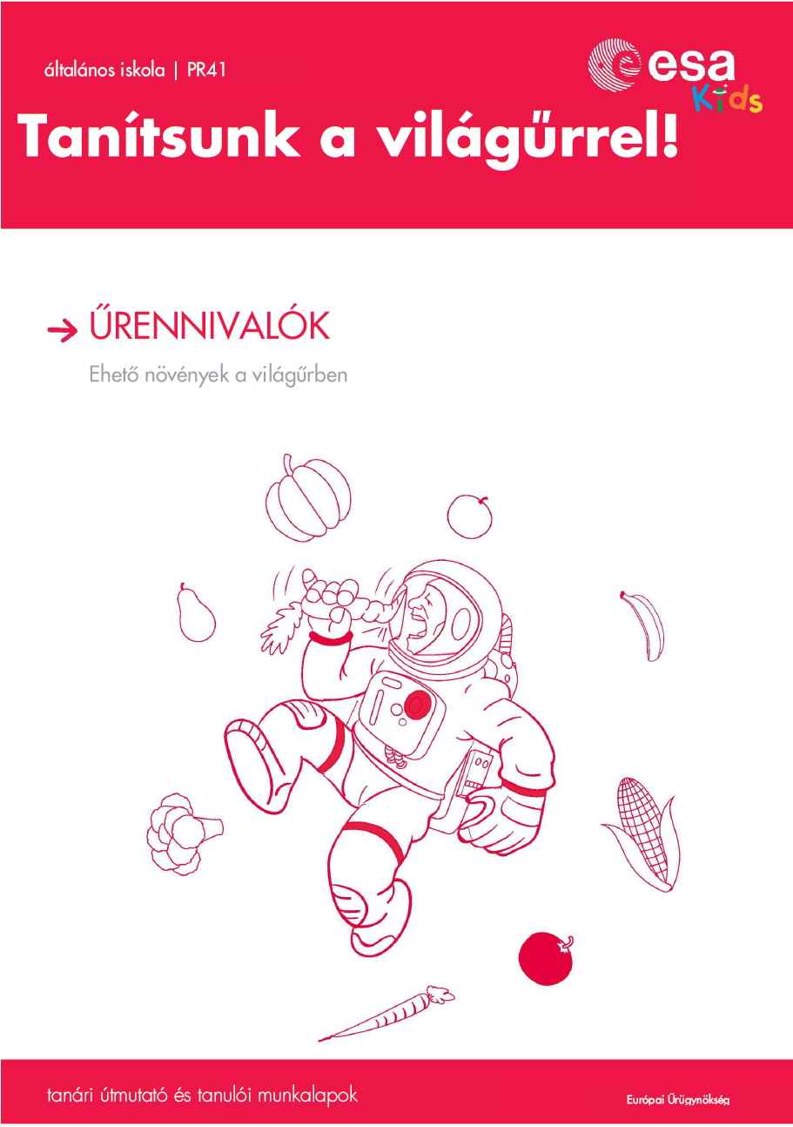
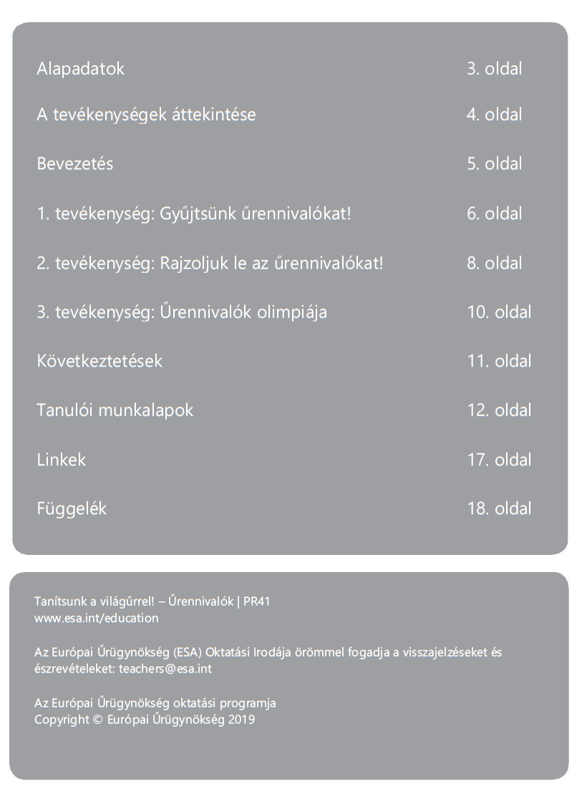
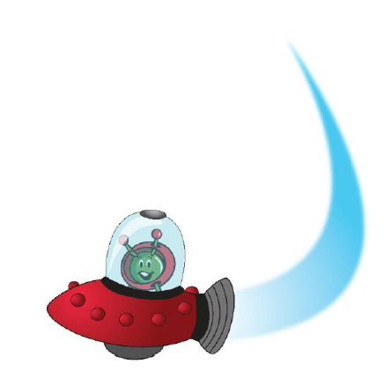
Székely Balázs egyetemi docens
Timár Gábor egyetemi tanár
Eötvös Loránd Tudományegyetem
Geofizikai és Űrtudományi Tanszék

Slide 2
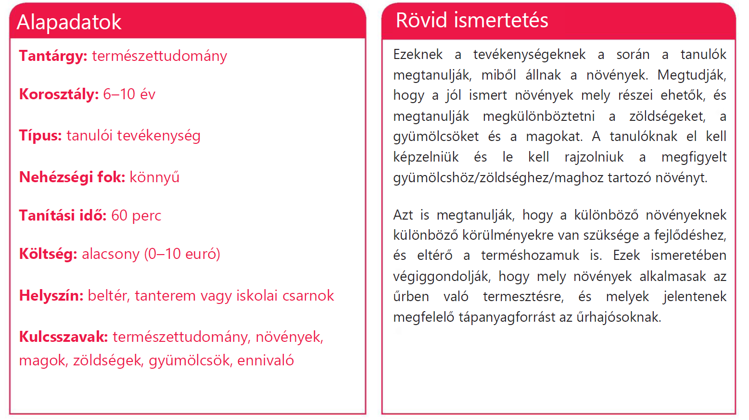

Slide 3
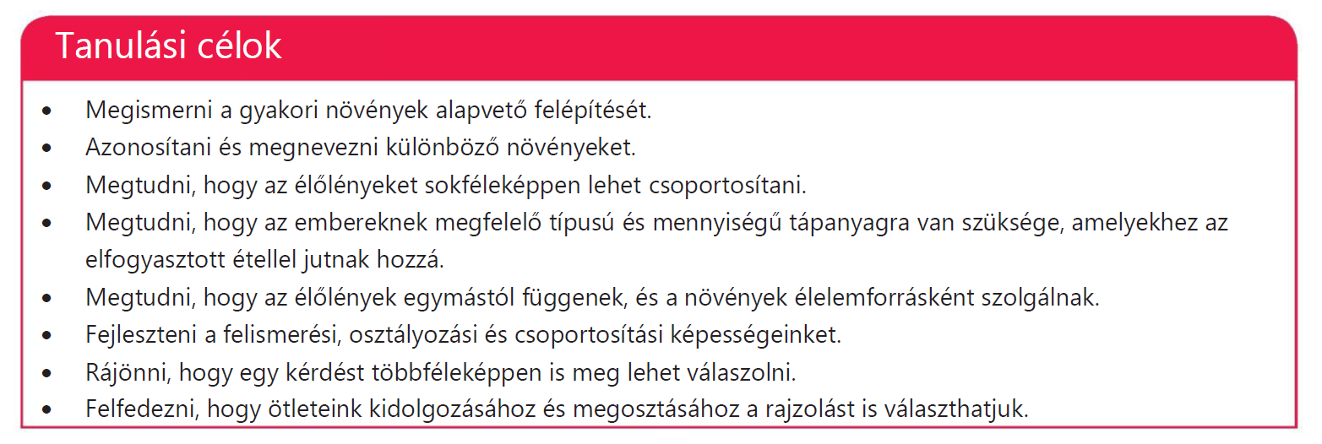

Slide 4
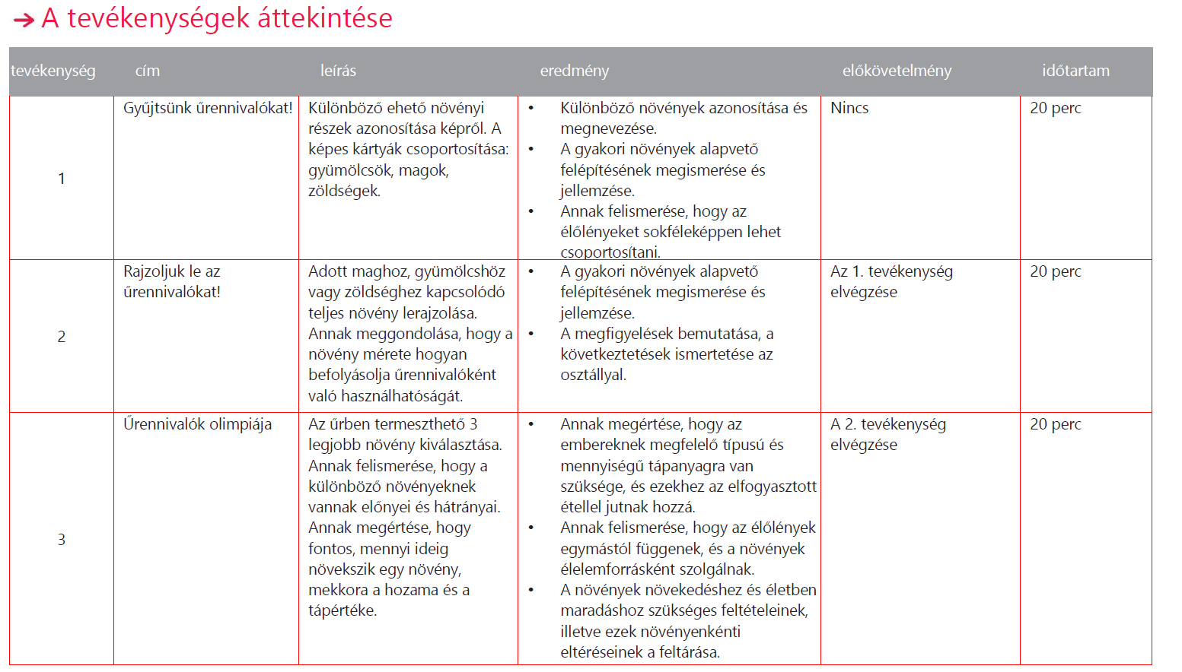

Slide 5
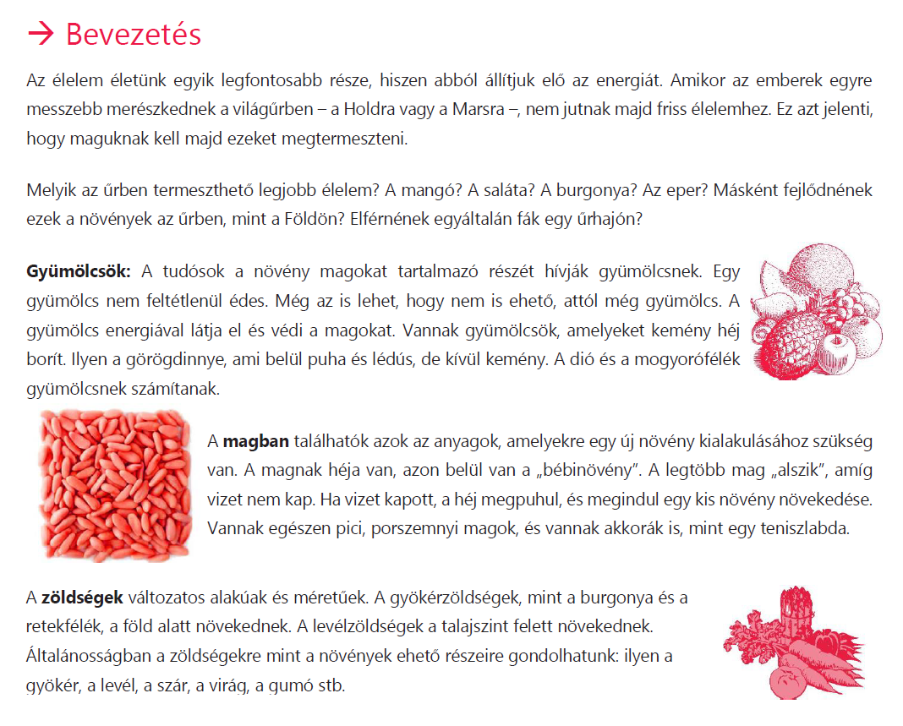
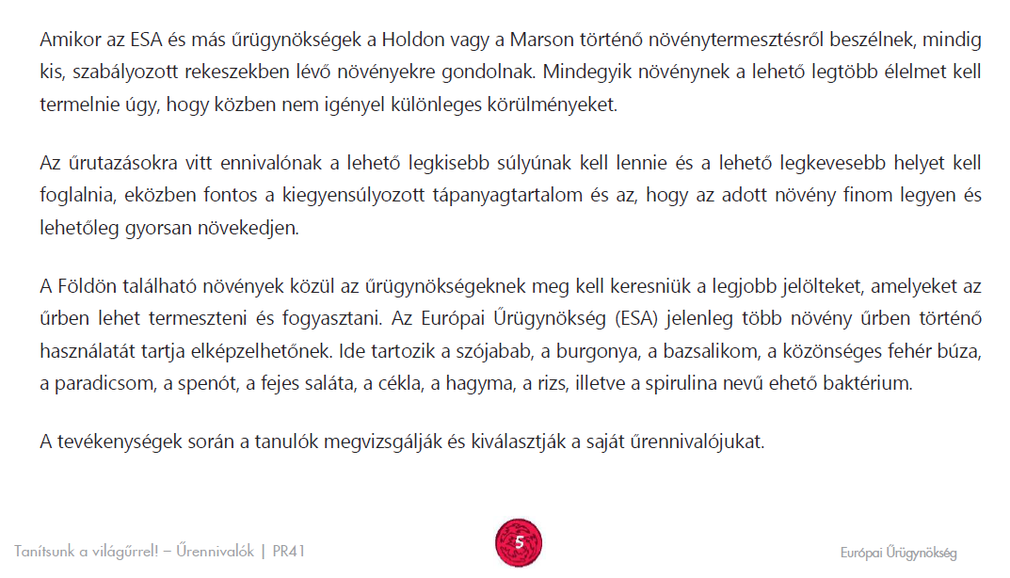

Slide 6
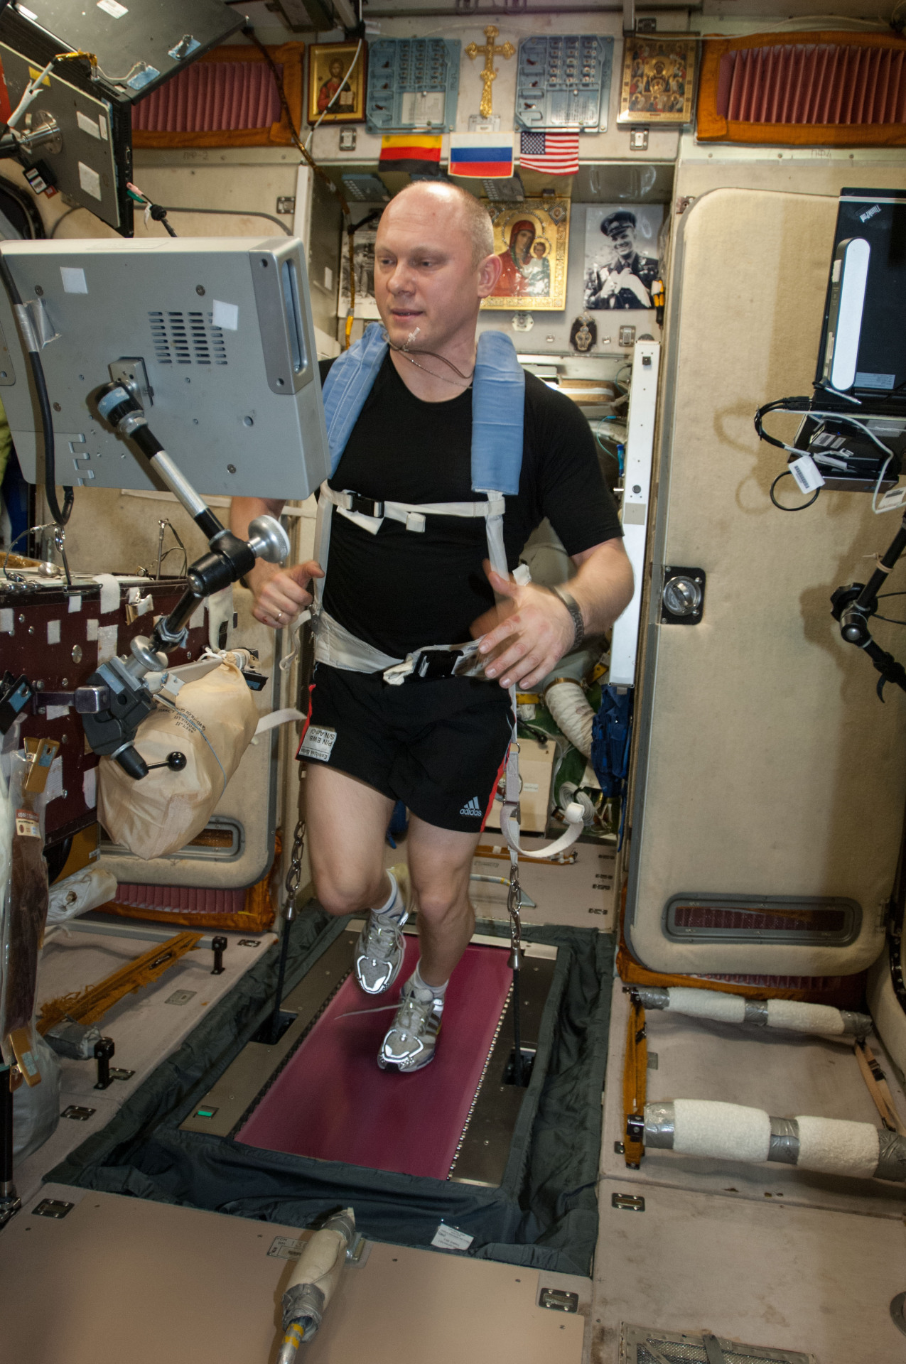
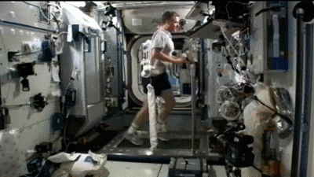
Astronaut nutrition
Astronauts require a balanced diet to maintain health in space.
Diet prevents muscle atrophy, bone loss, and oxidative stress.
Physiological effects of microgravity require careful planning of nutrition intake.

Slide 7
Maintaining Astronaut Health Through Diet
Several key strategies are employed to ensure astronaut health on extended missions.
1. Counteracting Bone and Muscle Loss
High-protein diets support muscle maintenance.
Calcium and Vitamin D supplements combat bone mineral loss.
Resistance exercise (treadmills, stationary bicycles) complements dietary strategies.
2. Managing Radiation Exposure
Antioxidants from fruits and vegetables may mitigate radiation damage.
Potential use of specialized supplements to enhance DNA repair mechanisms.
3. Psychological and Social Aspects of Eating
Meal variety and familiar foods improve morale.
Fresh food shipments (e.g., via cargo missions) boost psychological well-being.
Cultural preferences are considered in menu planning.

Slide 8
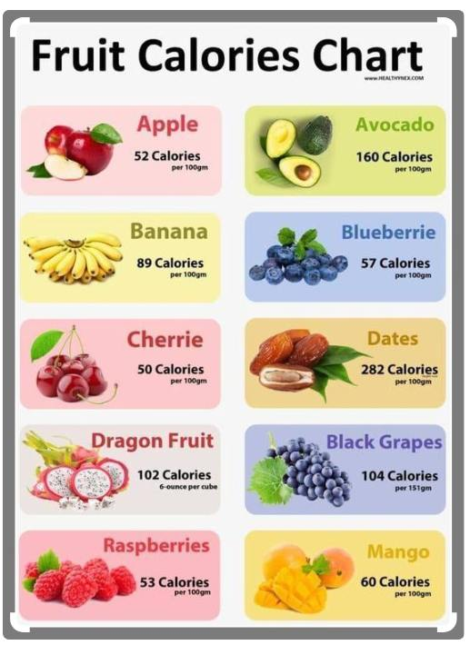
Daily Macronutrient Requirements
Calories:
2,500–3,800 kcal/day, adjusted for mission duration
and activity.
Protein:
1.2–1.5 g/kg/day to prevent muscle loss.
Carbohydrates:
50–55% of total intake, essential for energy.
Fats:
25–30% of total intake, important for brain function.

Slide 9
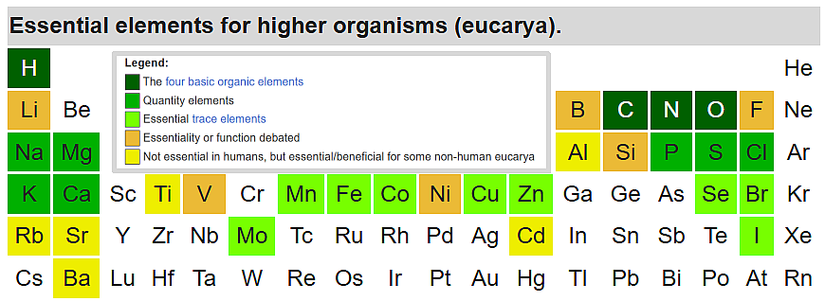
Essential Micronutrient Requirements
Micronutrients are essential for bone health, immune function, and metabolism.
Deficiencies or excesses can impact astronaut performance and health.

Slide 10
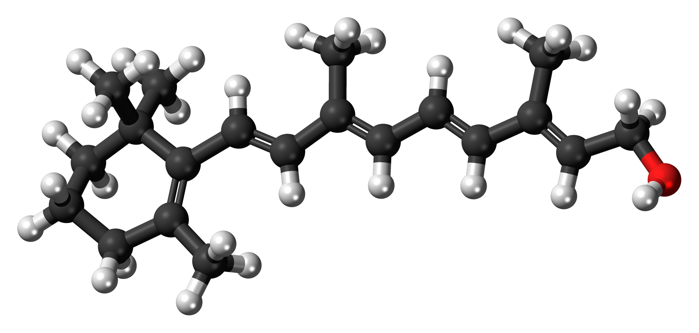
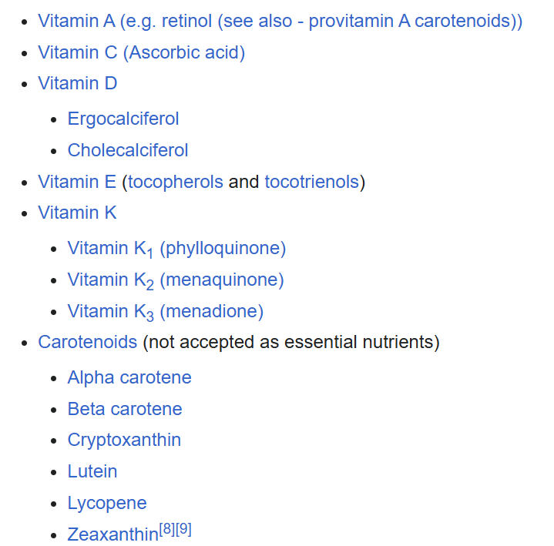
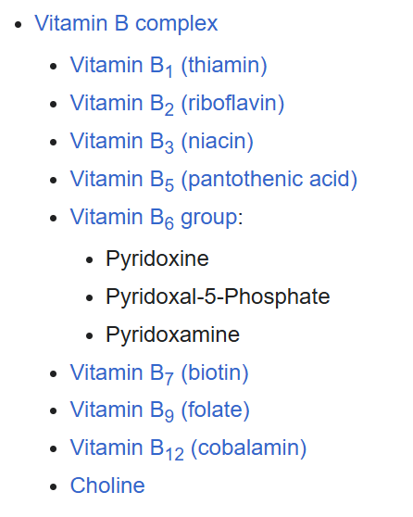
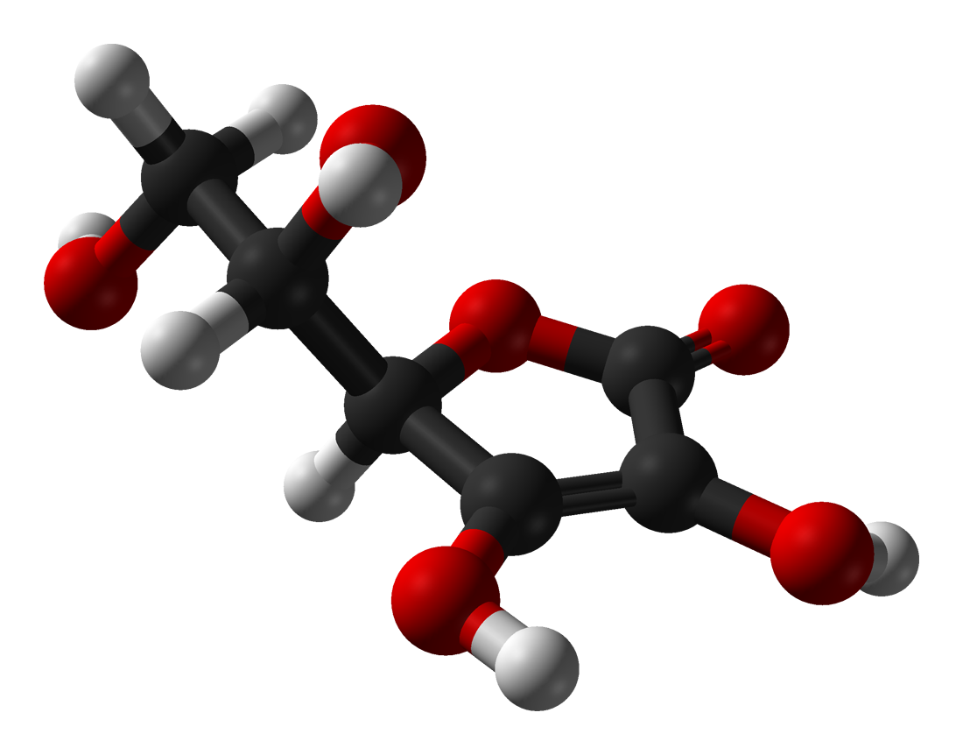
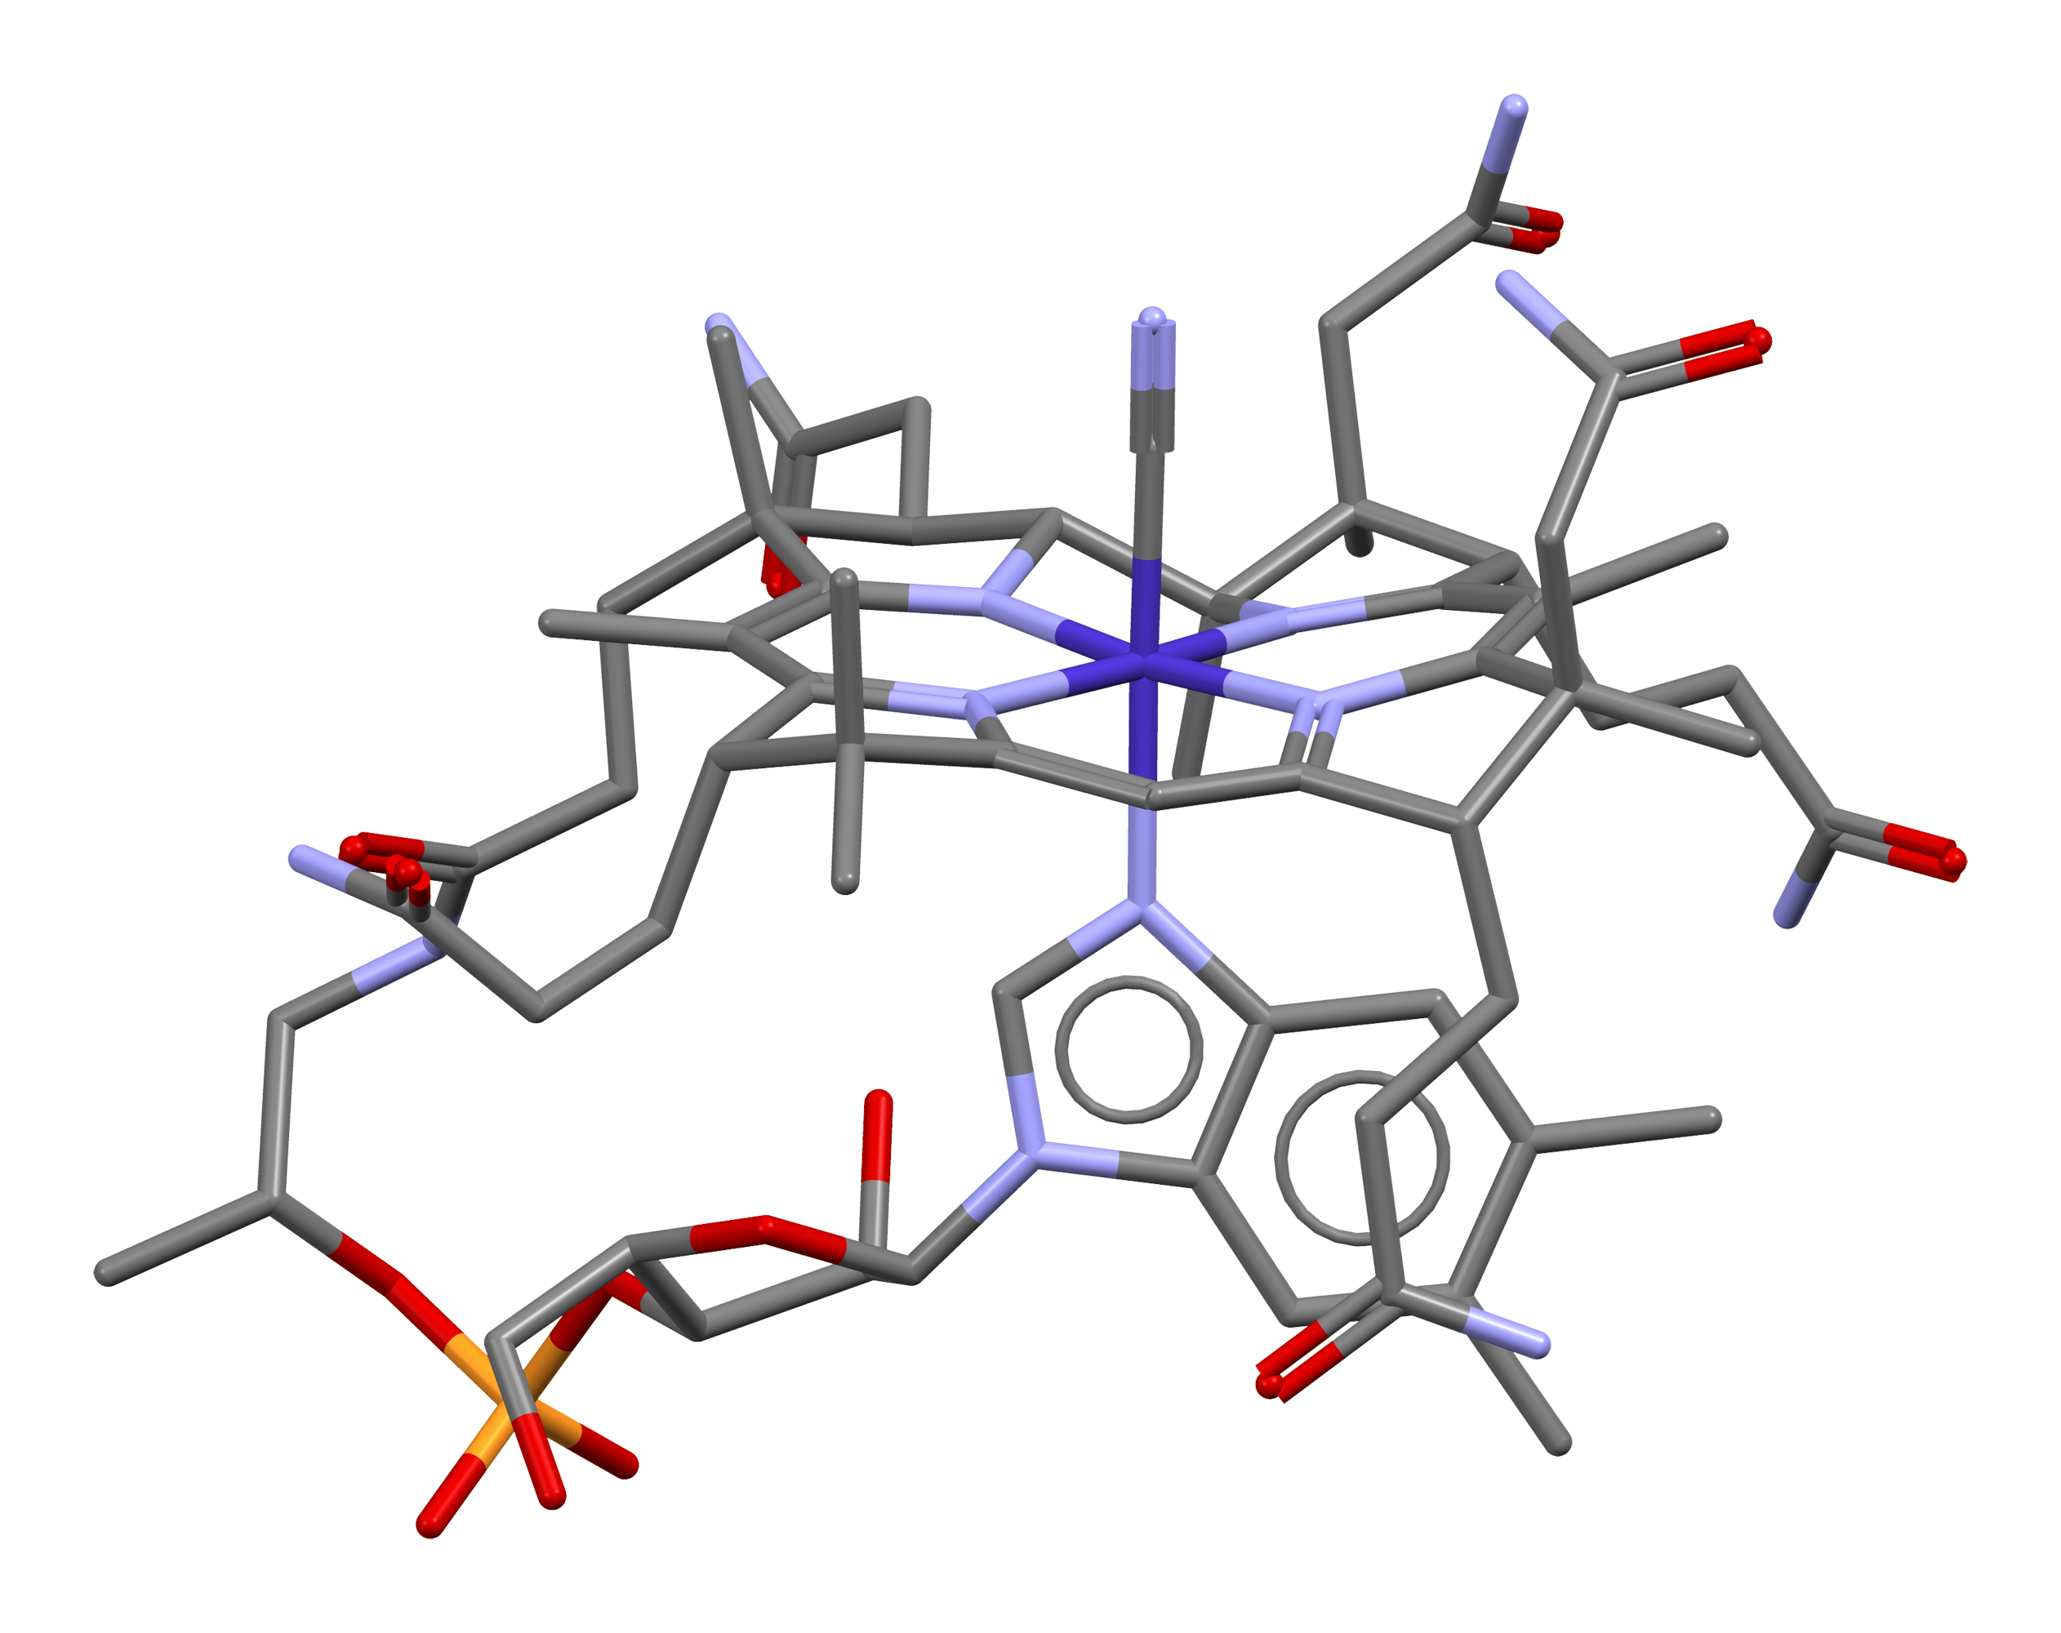
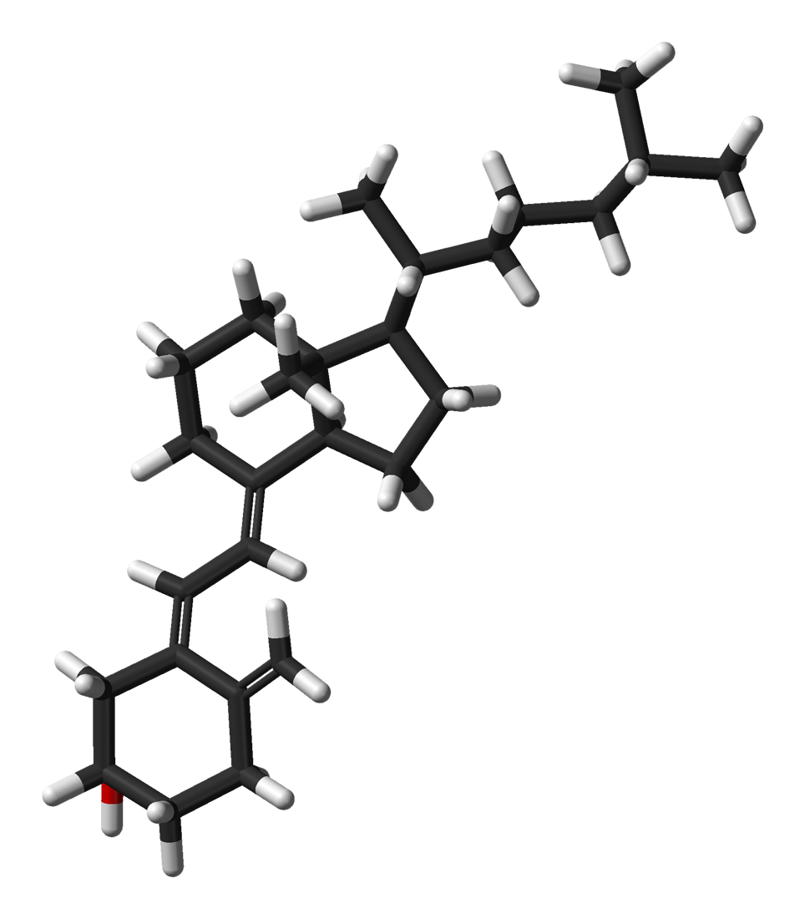
Vitamins
Vitamin A: 900 μg (male), 700 μg (female) – Eye health, immune function.
Vitamin B Complex: Supports energy metabolism and nervous system function.
Vitamin C: 90 mg (male), 75 mg (female) – Antioxidant, reduces radiation effects.
Vitamin D: 800–1,000 IU – Prevents bone loss.

Slide 11
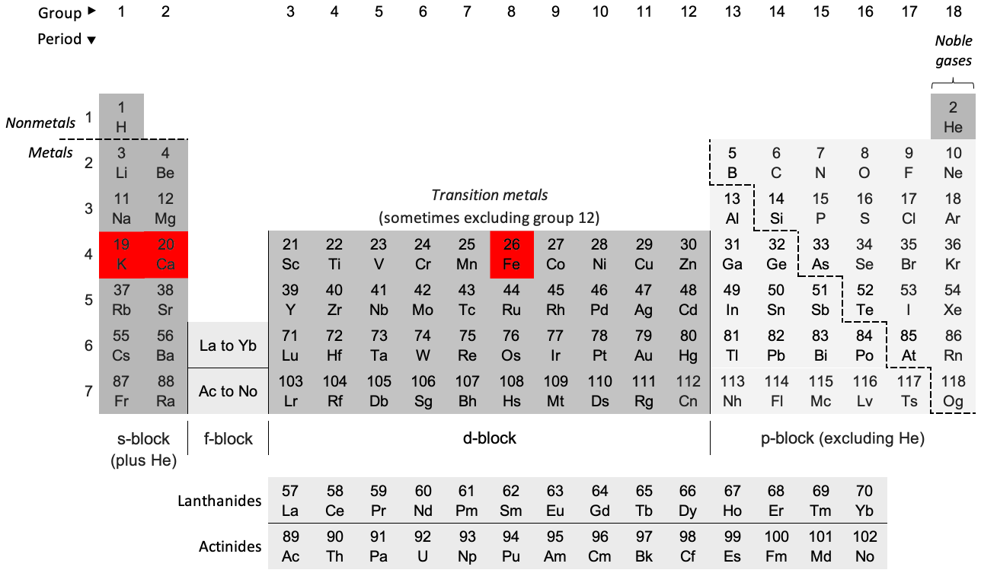
Minerals and Electrolytes
Calcium: 1,200 mg – Required due to bone loss in microgravity.
Iron: 8 mg (male), 18 mg (female) – Essential for oxygen transport.
Potassium: 3,500–4,700 mg – Regulates muscle contraction and hydration.

Slide 12
Gender-Specific Considerations
Males require more calories due to higher muscle mass.
Females need higher iron intake due to menstruation.
Calcium intake is critical for both genders to prevent osteoporosis.
Protein metabolism is similar, but males may require more.
Hydration and Fluid Requirements
Water intake: 2.5–3.5 liters/day.
Hydration is critical to prevent dehydration in microgravity.
93% of water is recycled onboard through filtration systems.
Outlook
Astronaut nutrition ensures mission success by preventing health issues.
Future lunar and Mars missions require further refinements in dietary planning.
Sustainable food production and personalized nutrition will play key roles.

Slide 13
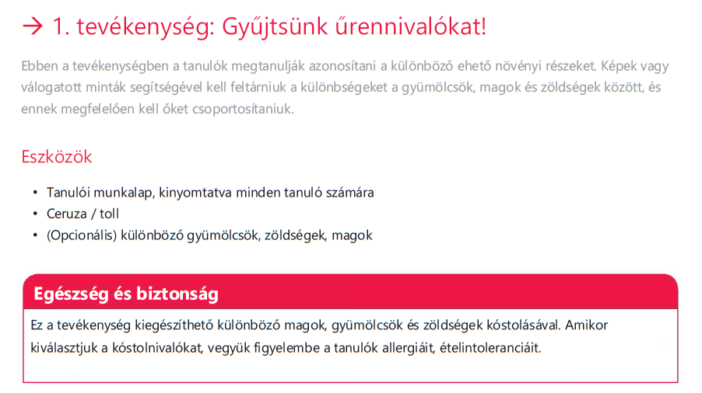
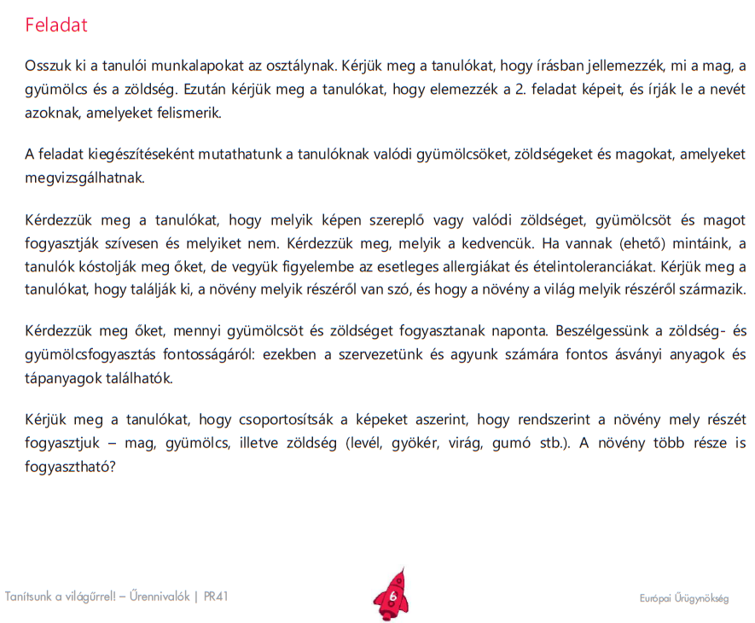

Slide 14
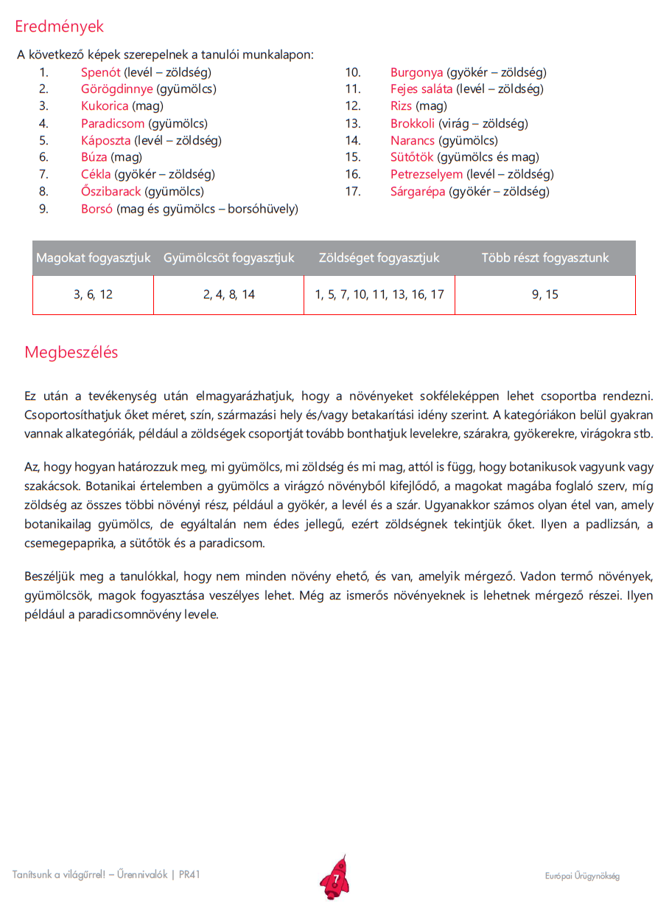

Slide 15
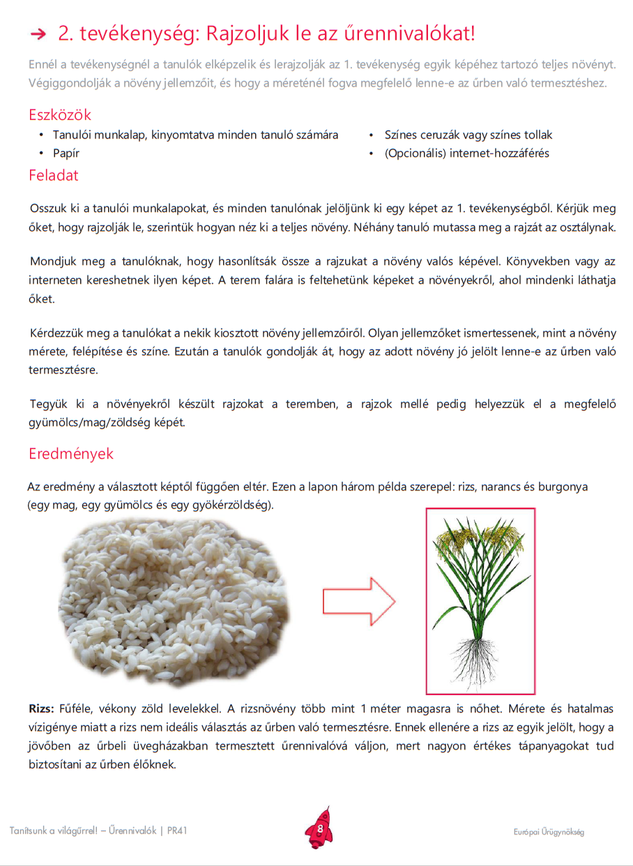

Slide 16
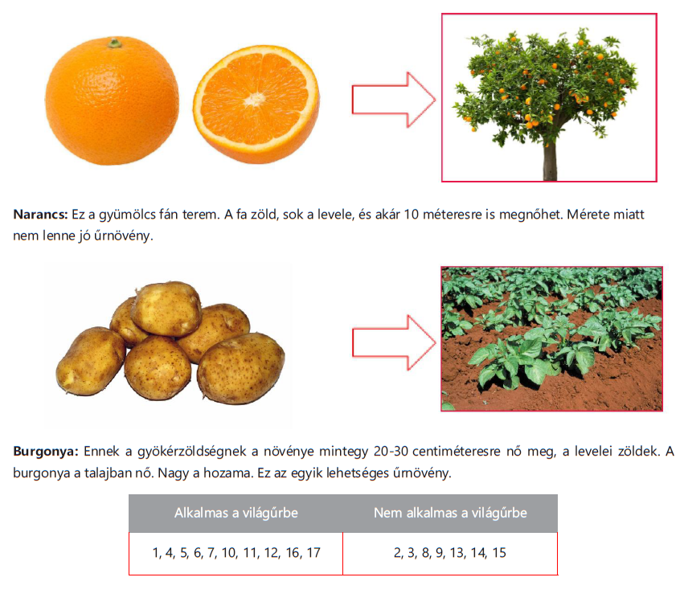
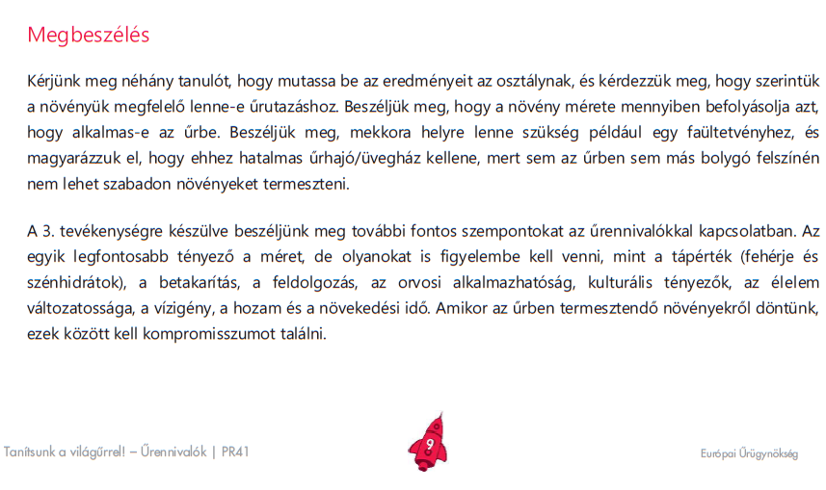

Slide 17
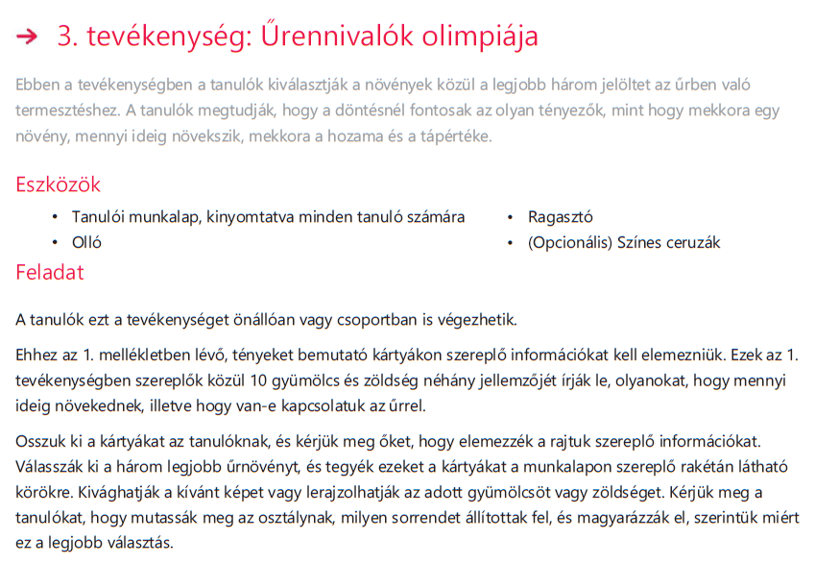
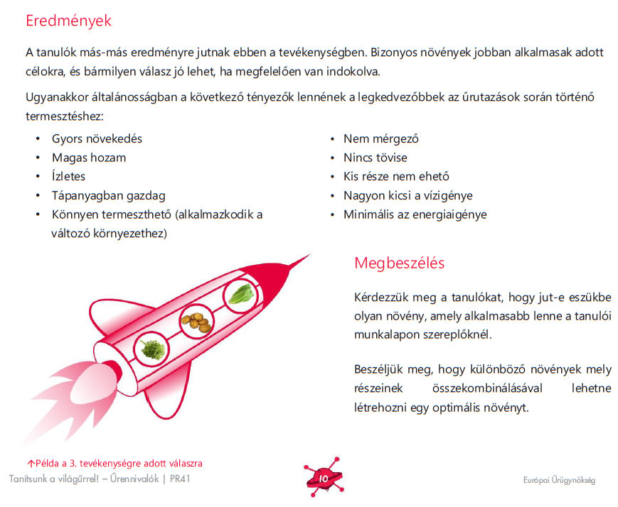
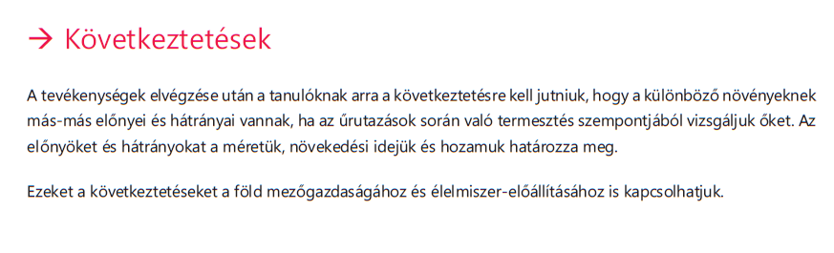

Slide 18
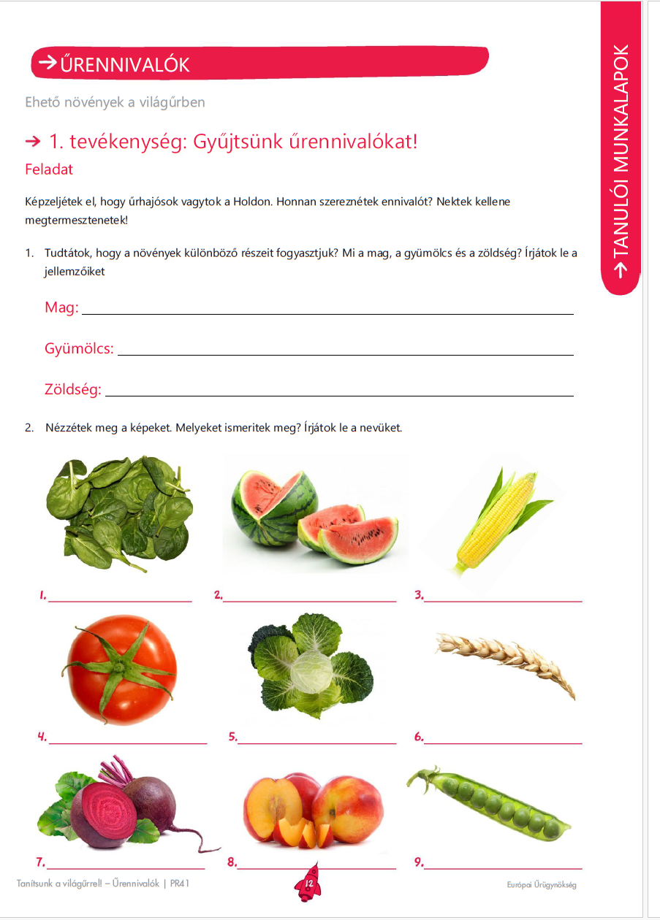
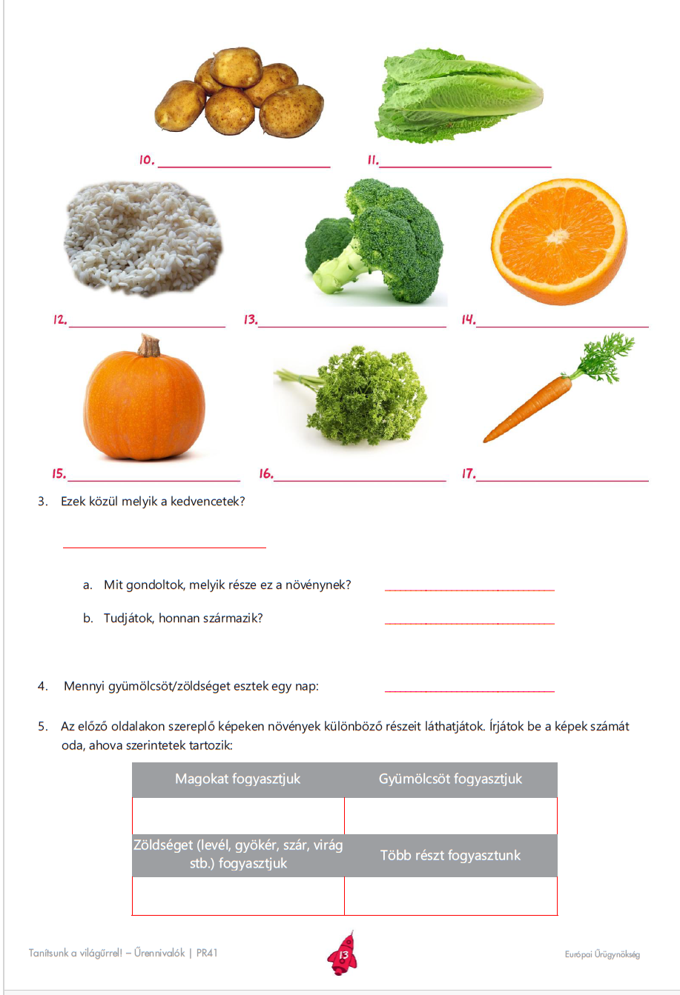

Slide 19
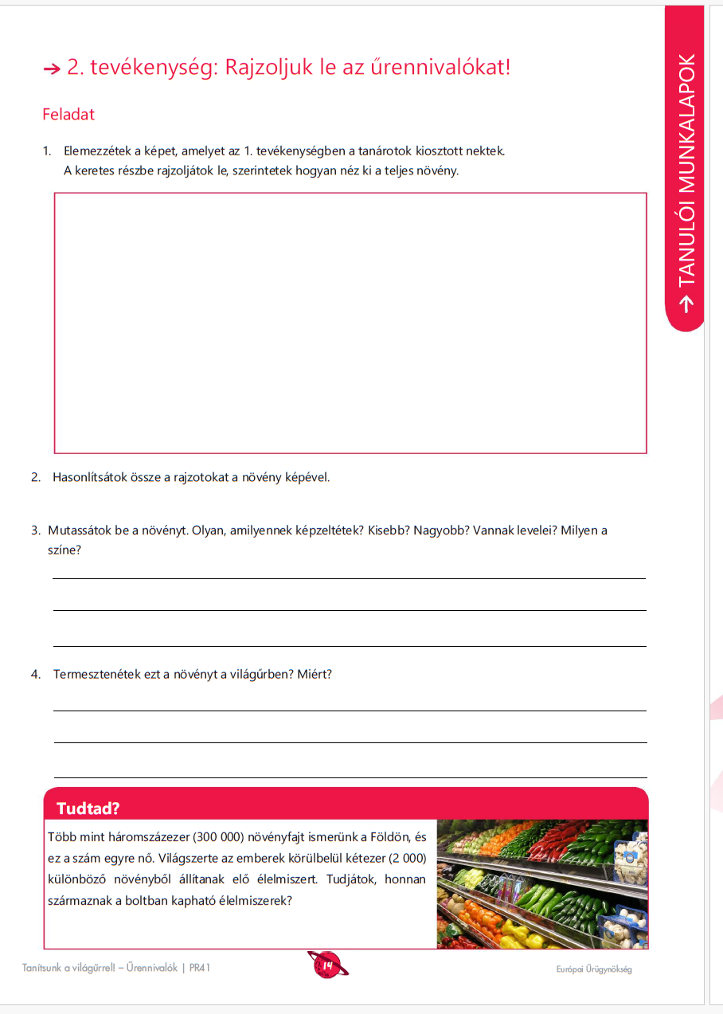
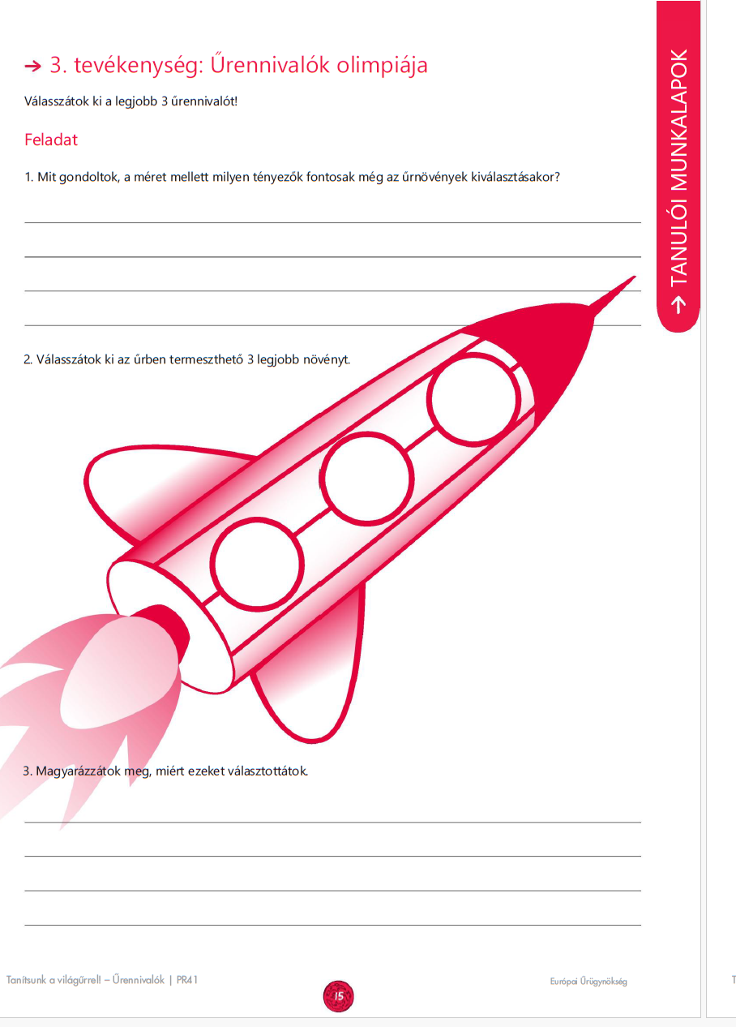

Slide 20

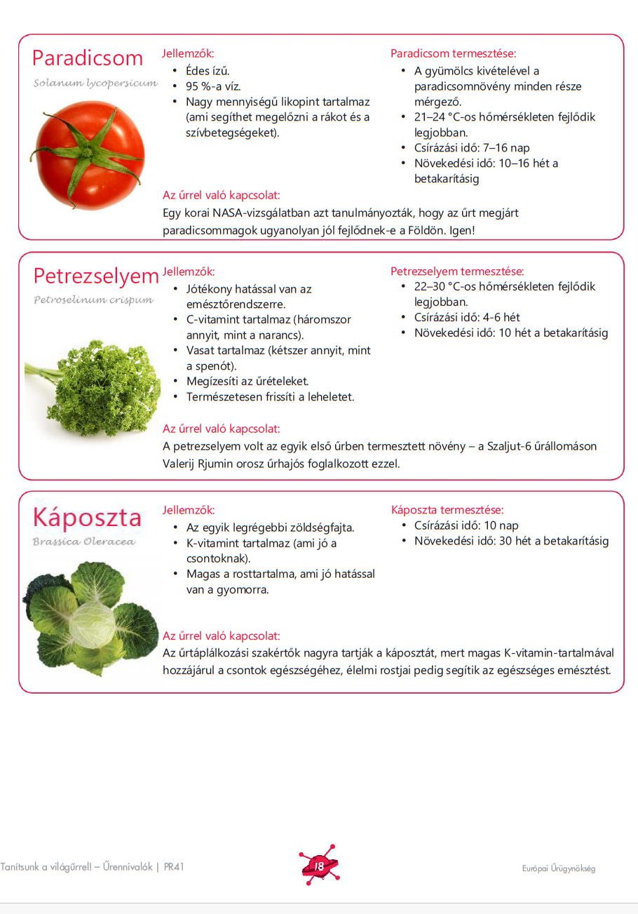

Slide 21
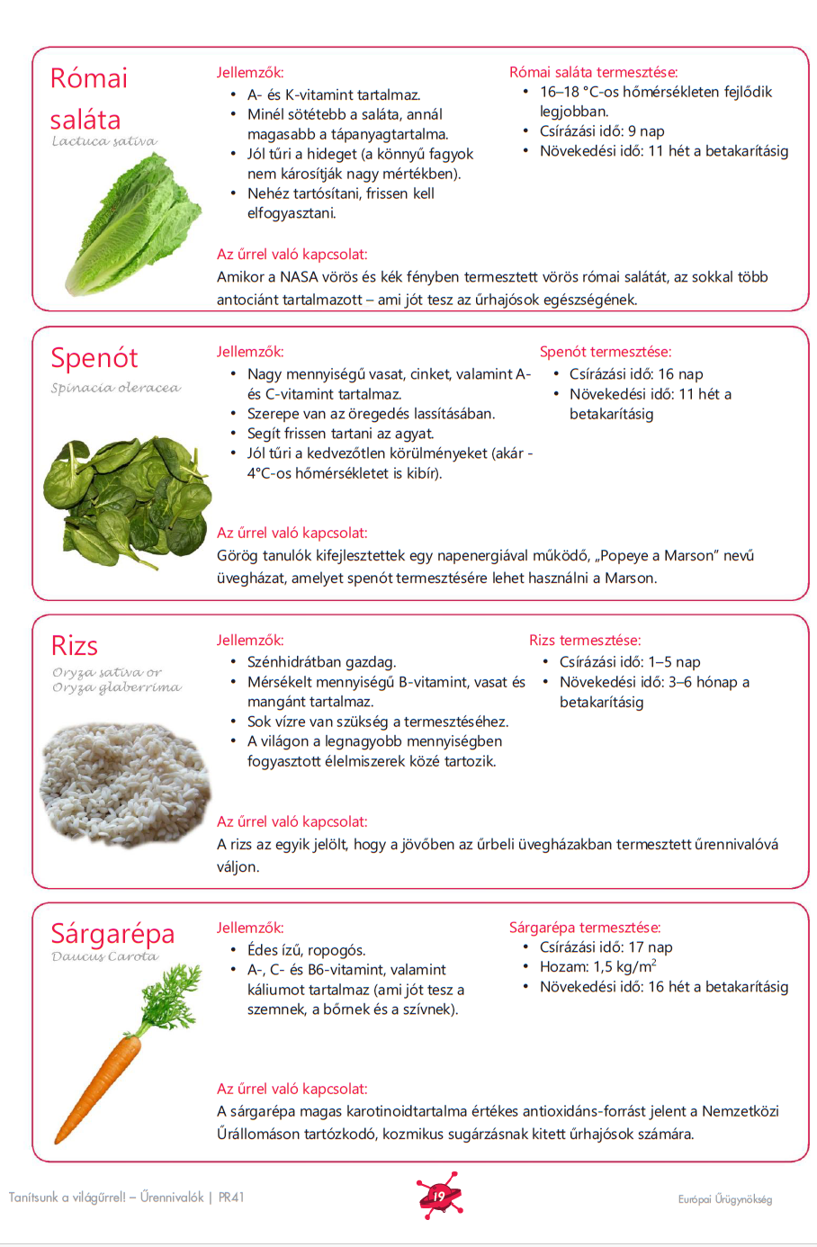
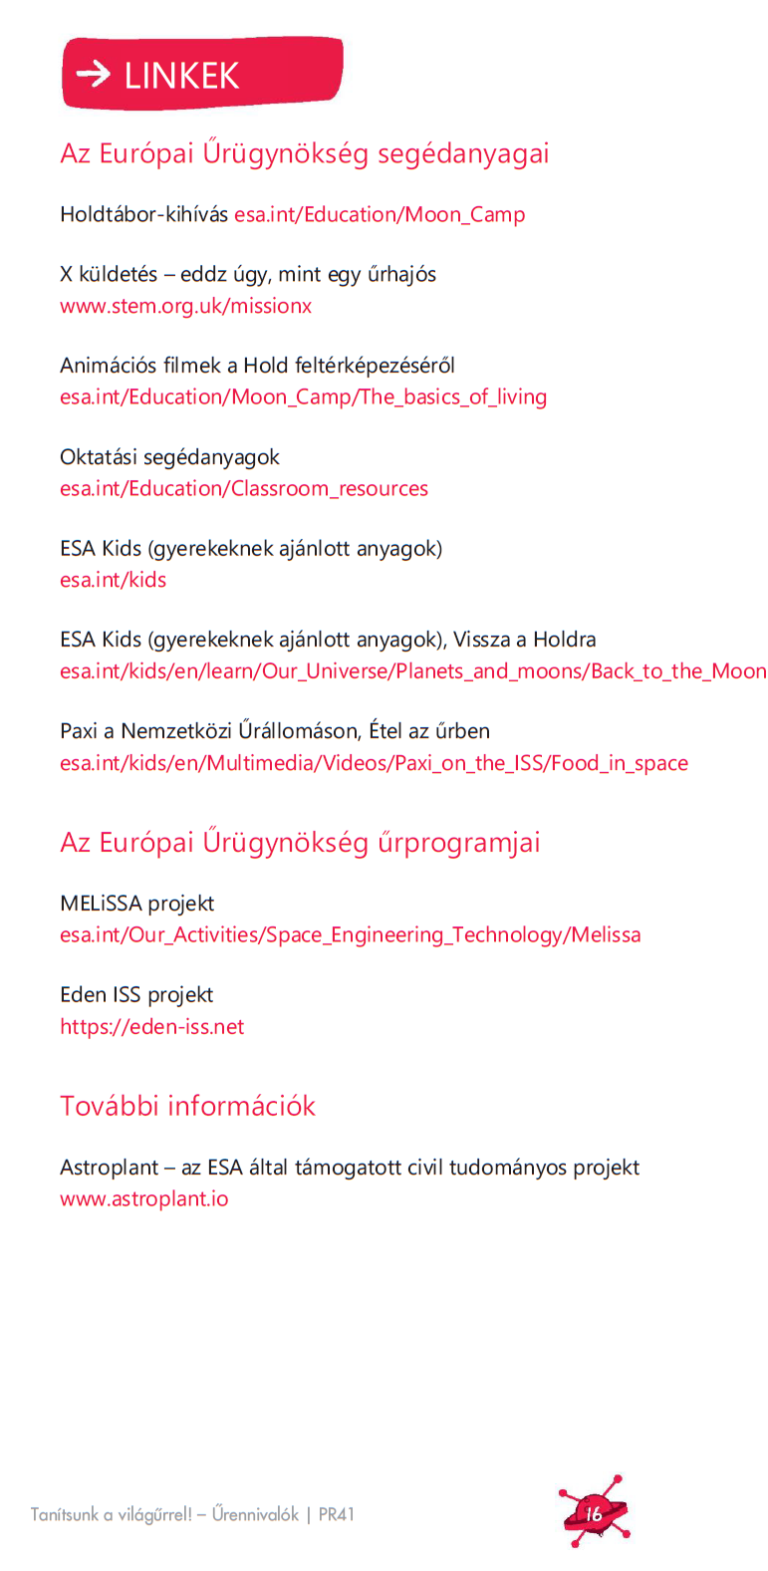

Slide 22
